Slide 1
GATTING STARTED WITH
POWERPOINT

Slide 2
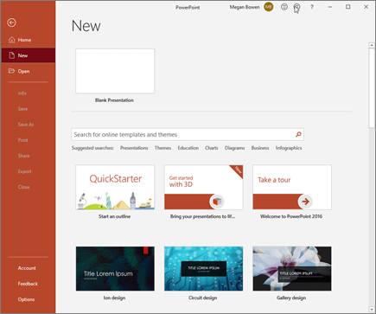
1.Openpowerpoint 2.In the left pane , select new 3.Select an option:
Create a presentation inPowerPoint

Slide 3
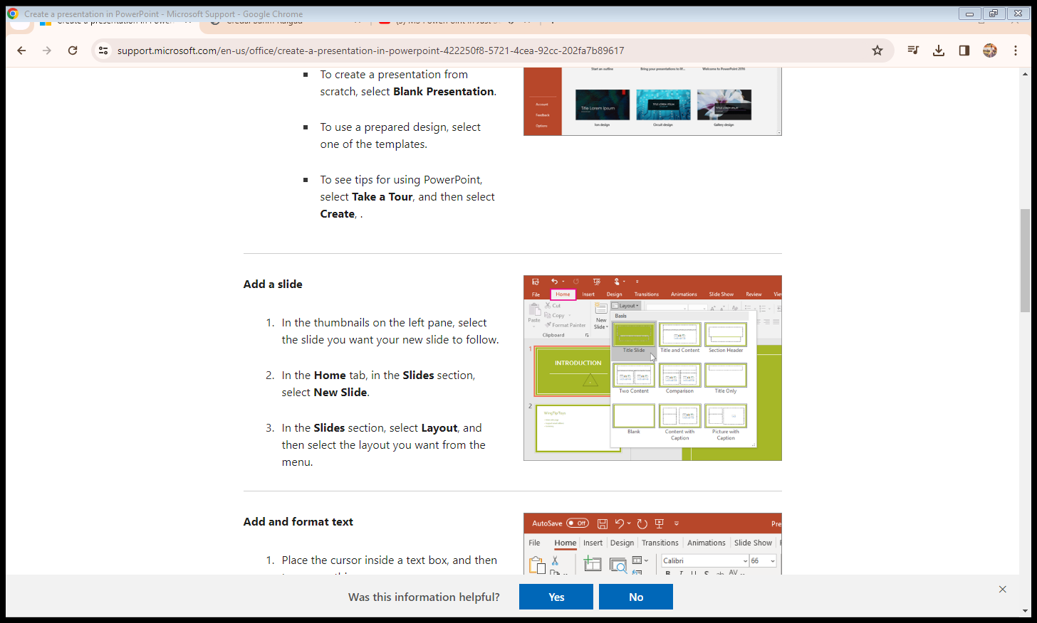
Add a slide
1. In the thumbnails on the left pane, select the slide you want your new slide to follow.
2.In the Home tab, in the Slides section, select New Slide.
3.In the Slides section, select Layout, and then select the layout you want from the menu.

Slide 4
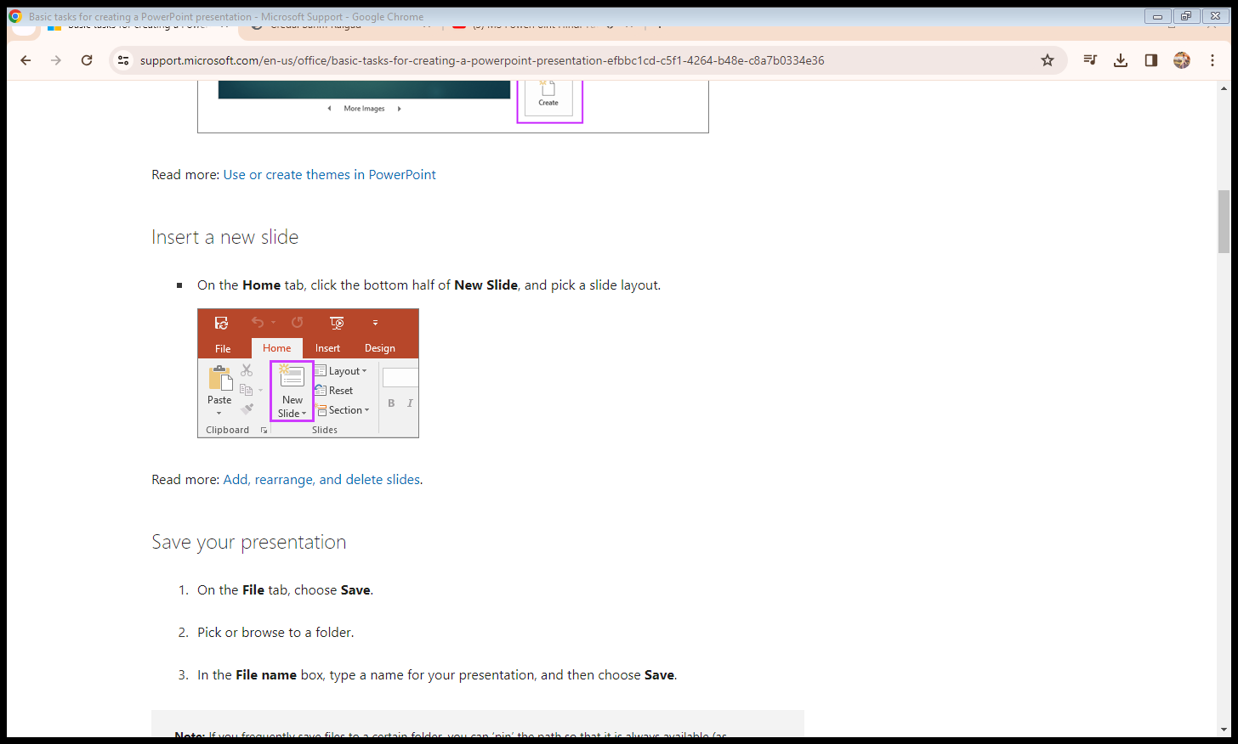
Insert a new slide 1. on the home tab, click the bottom half of new slide, and pick a slide layout.

Slide 5
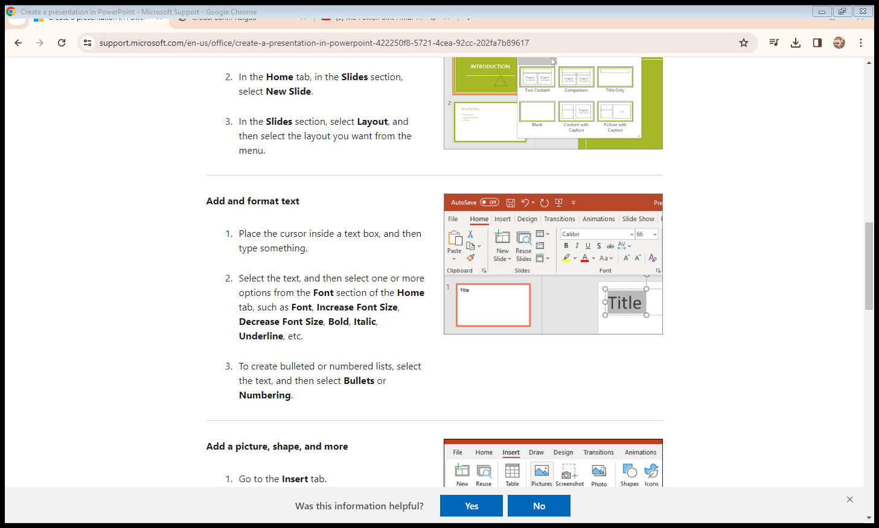
Add and format text
1. Place the cursor inside a text box, and then type something.
2. Select the text, and then select one or more options from the Font section of the Home tab, such as Font, Increase Font Size, Decrease Font Size, Bold, Italic, Underline, etc.
3. To create bulleted or numbered lists, select the text, and then select Bullets or Numbering.

Slide 6
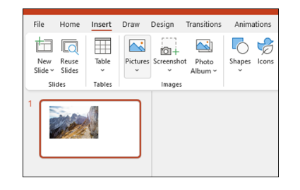
INSERT
1. Go to the Insert tab.
2. To add a picture:

Slide 7
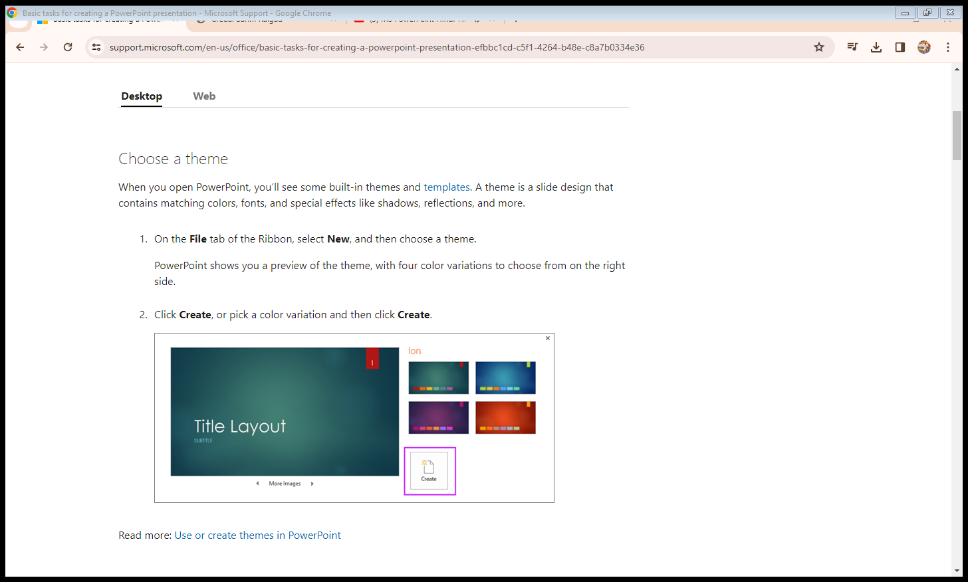
1.On the file tab of the ribbon, select new, and then choose a theme. Powerpoint shows you a preview of the theme, with four color variations to choose from on the right side. 2. Click create, or pick a color variation and then click create.

Slide 8
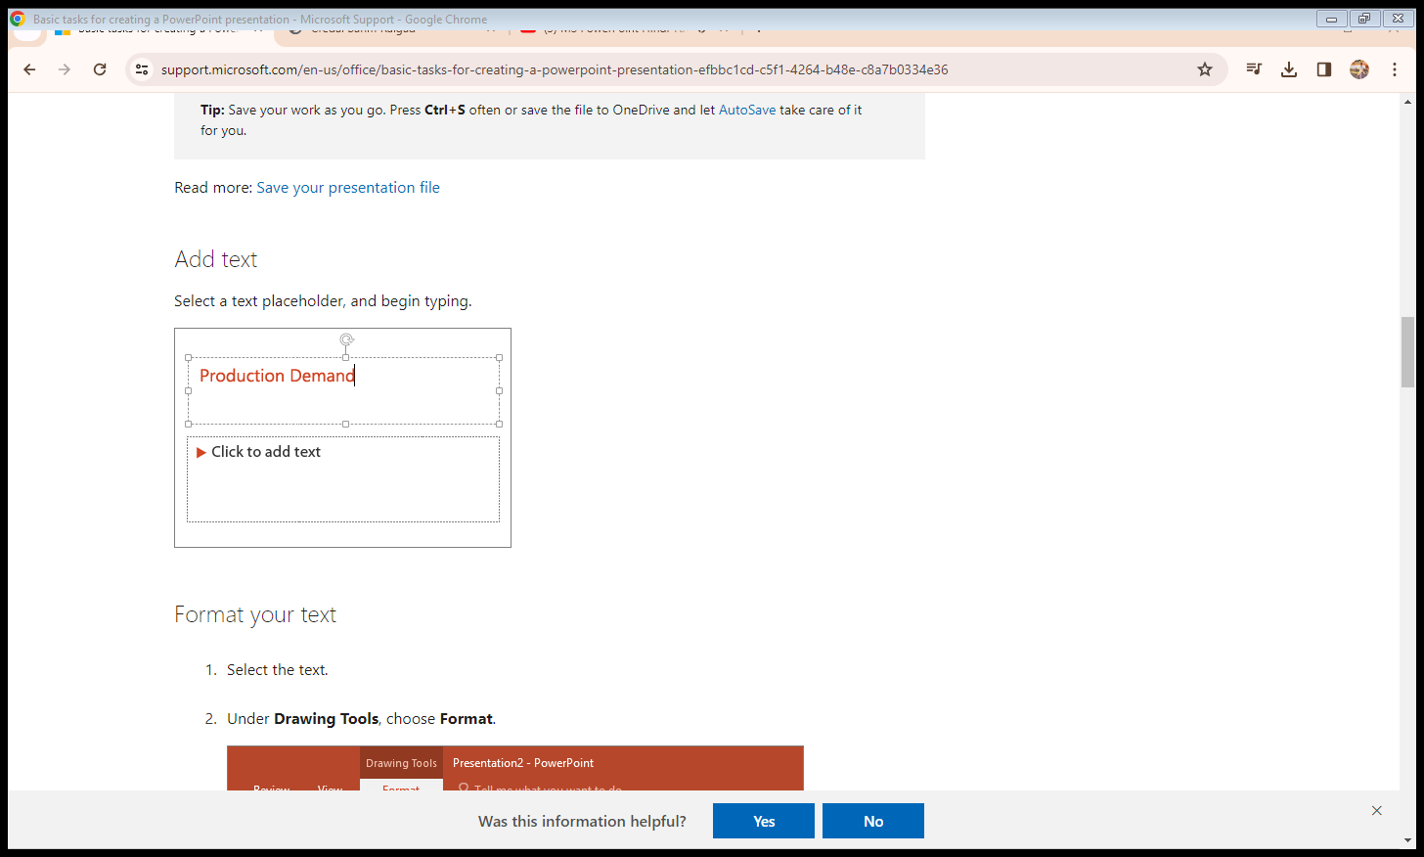
1 . Select a text placeholder, and begin typing.

Slide 9
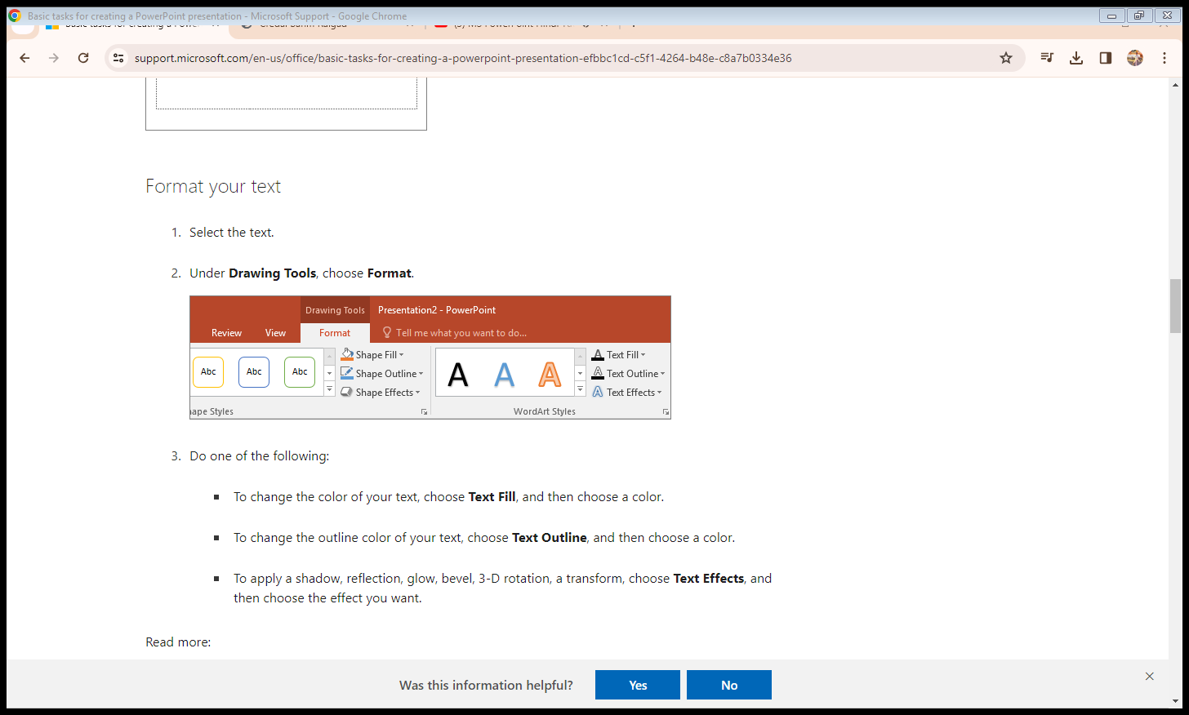
1. Select the text. 2. Under Drawing Tools, choose Format.

Slide 10
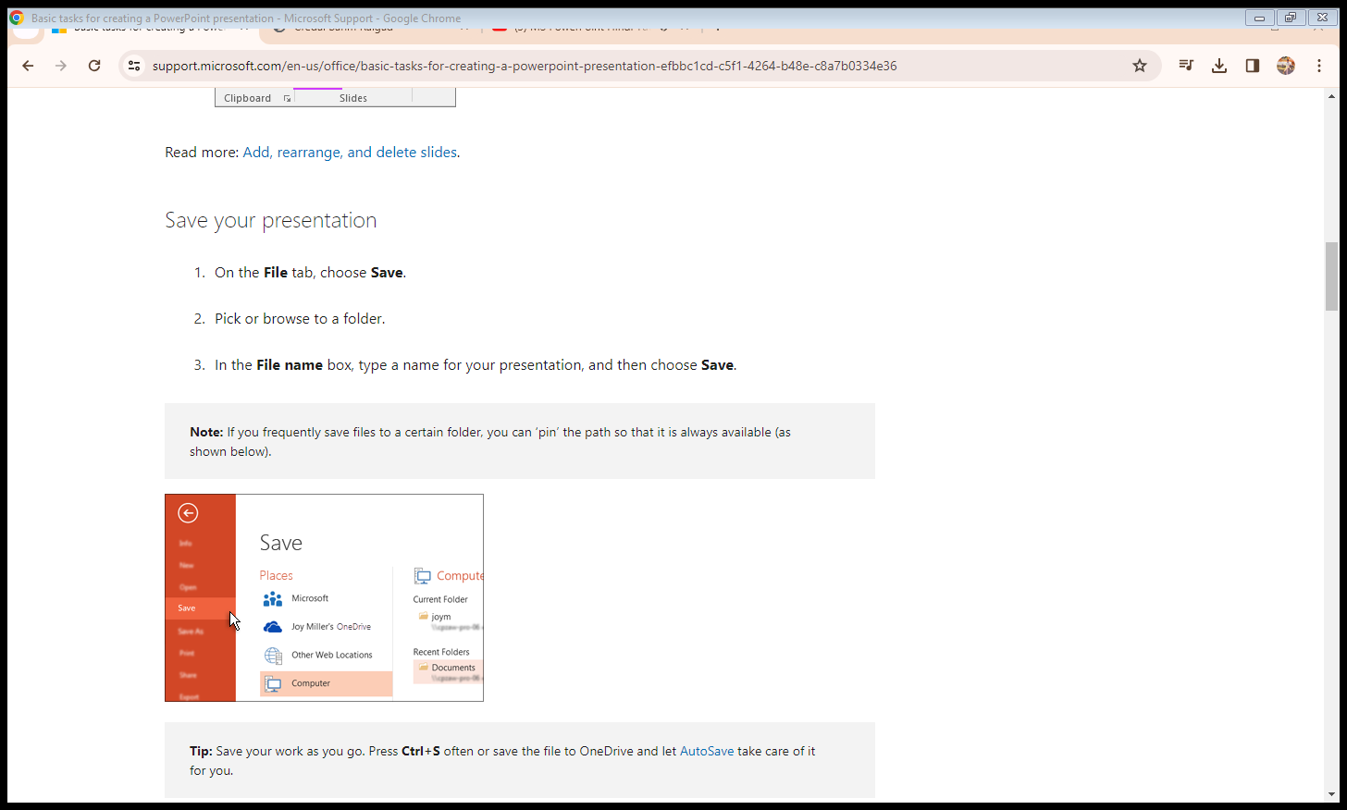
Save your presentation 1. On the File tab, choose Save. 2. Pick or browse to a folder. 3. In the File name box, type a name for your presentation, and then choose Save

Slide 11
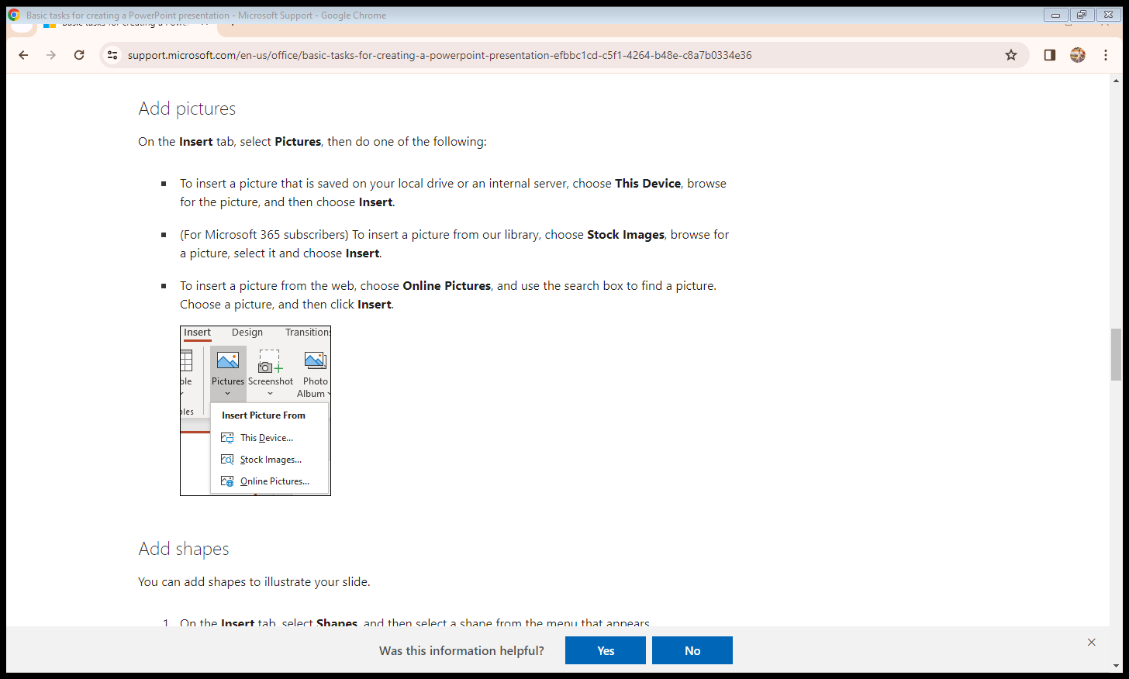
Add pictures On the Insert tab, select Pictures, then do one of the following: 1. To insert a picture that is saved on your local drive or an internal server, choose This Device, browse for the picture, and then choose Insert. 2. (For Microsoft 365 subscribers) To insert a picture from our library, choose Stock Images, browse for a picture, select it and choose Insert. 3. To insert a picture from the web, choose Online Pictures, and use the search box to find a picture. Choose a picture, and then click Insert.

Slide 12
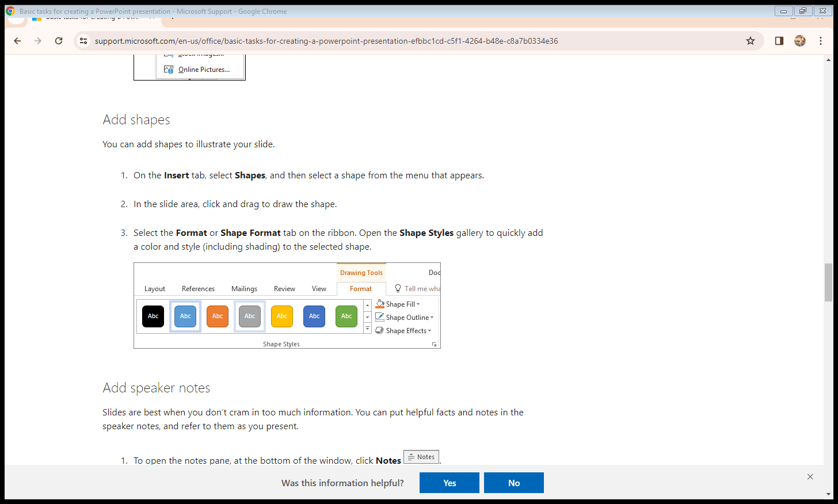
Add shapes You can add shapes to illustrate your slide. 1. On the Insert tab, select Shapes, and then select a shape from the menu that appears. 2. In the slide area, click and drag to draw the shape. 3. Select the Format or Shape Format tab on the ribbon. Open the Shape Styles gallery to quickly add a color and style (including shading) to the selected shape.

Slide 13
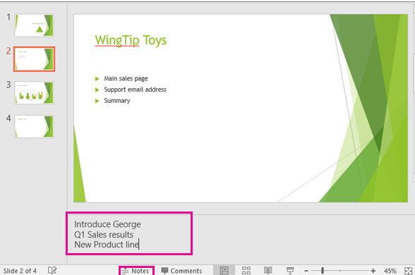
1. To open the notes pane, at the bottom of the window, click Notes . 2. Click inside the Notes pane below the slide, and begin typing your notes.

Slide 14
THANK YOU

